Slide 1
Diverse Vision-Based Puzzle Solver
P556 Final Project (Group 8)
INDIANA UNIVERSITY

Slide 2
The Problem
SECTION 1

Slide 3
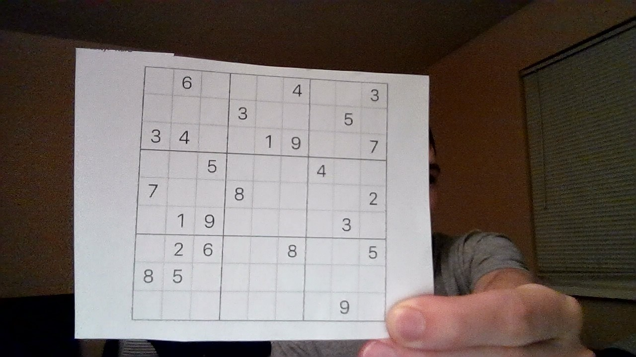
What is the solution to this puzzle?

Slide 4
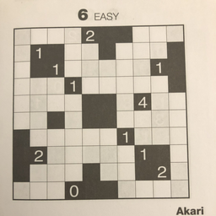
Or how about this one?

Slide 5
Prior Work
SECTION 2

Slide 6
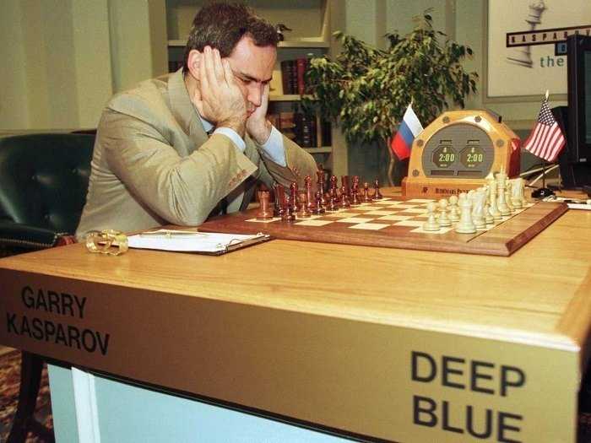
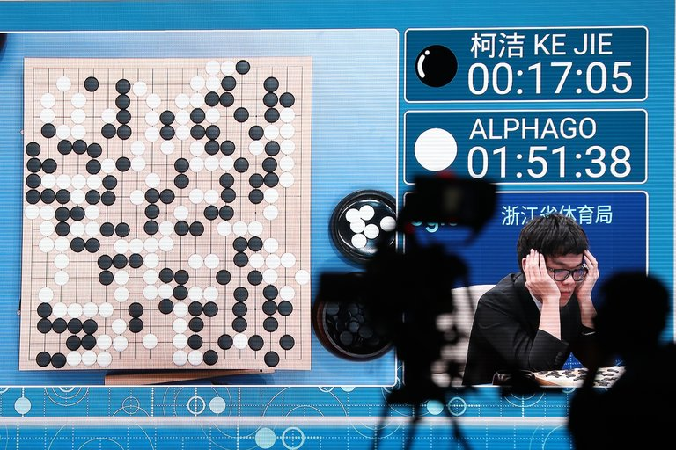
Prior Work – Puzzles & Vision
Touchstone of learning & intelligence
Puzzles & Games:
Deep Blue (IBM)
AlphaGo (Google)
Pedagogical Tools
CV Information Extraction
(see last slide for references)

Slide 7
Approach
SECTION 3

Slide 8
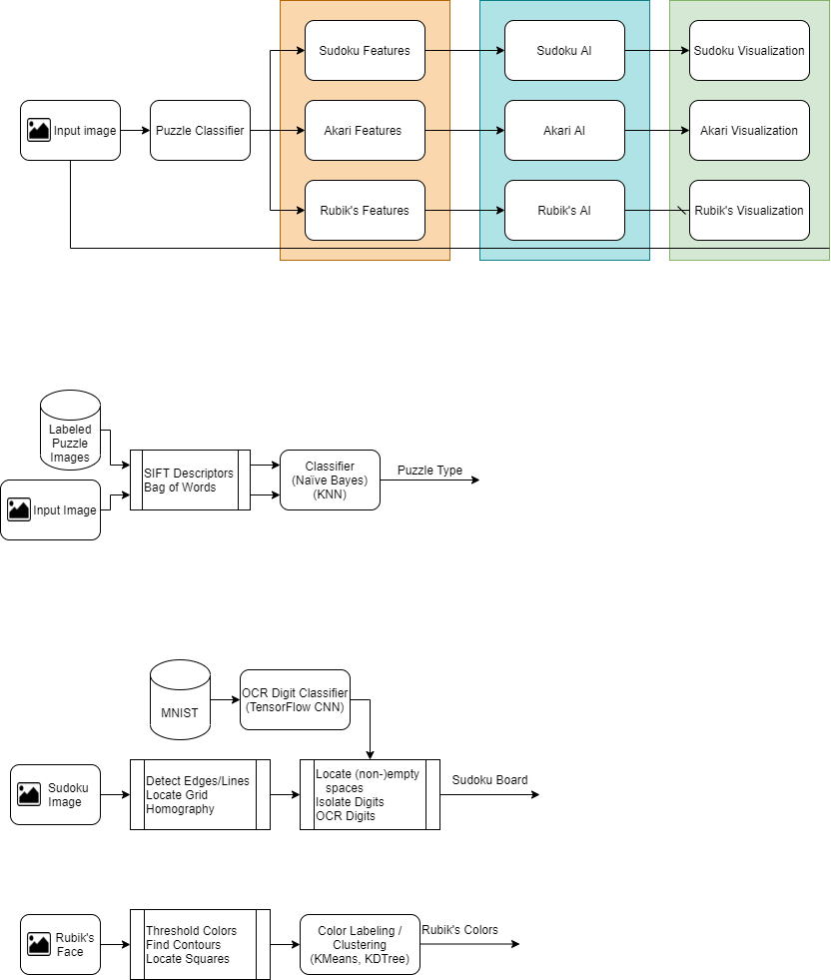
General Approach

Slide 9
Experiments & Implementation
SECTION 4

Slide 10

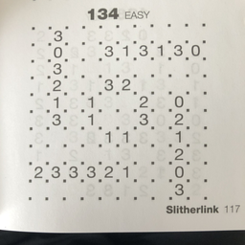
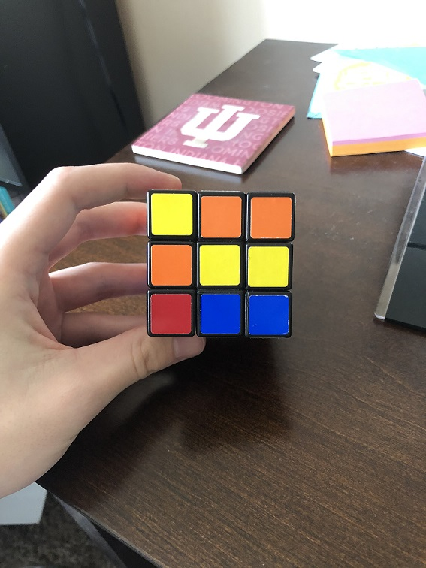
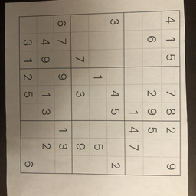
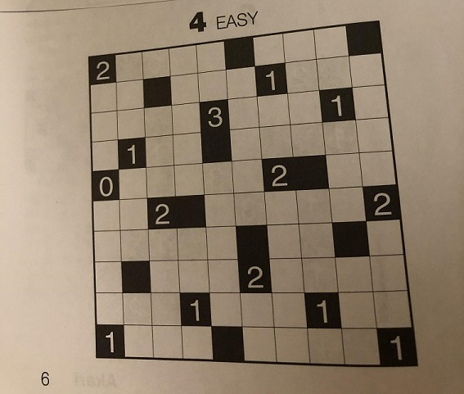
Input Images

Slide 11
Puzzle-type Classifier

Slide 12
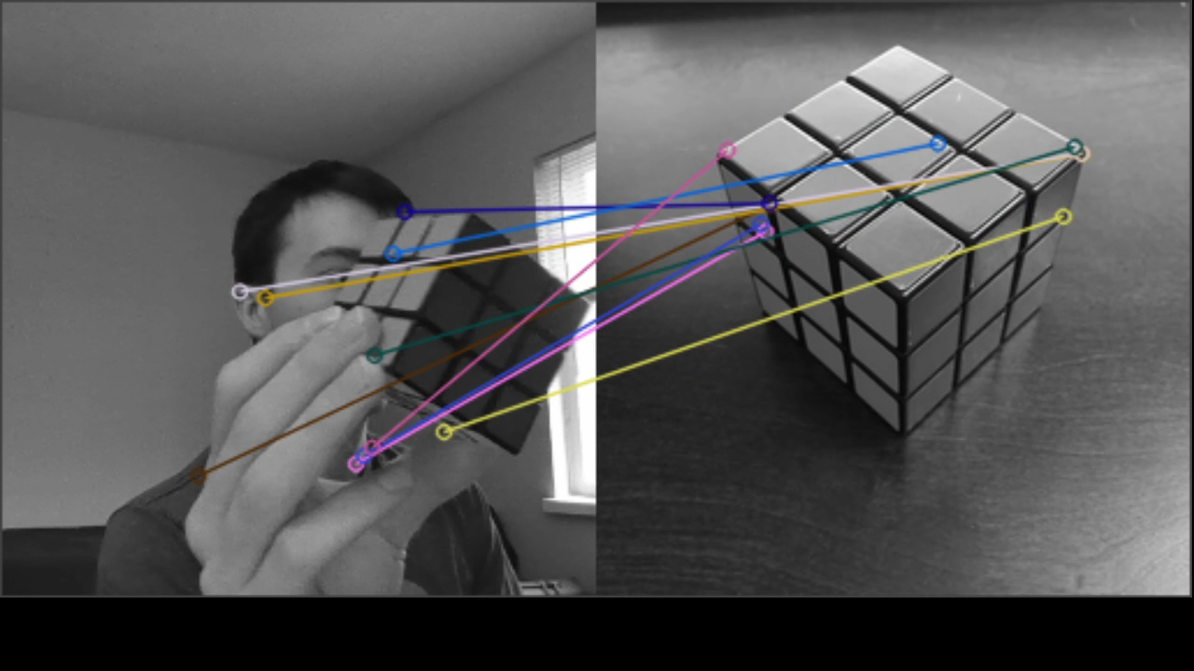
Puzzle-type Classifier Evaluation / Results
Very small dataset (~40 images)
Neural Networks not an option
Difficult to evaluate performance
Video, with multiple frames, demonstrates classifier accuracy

Slide 13
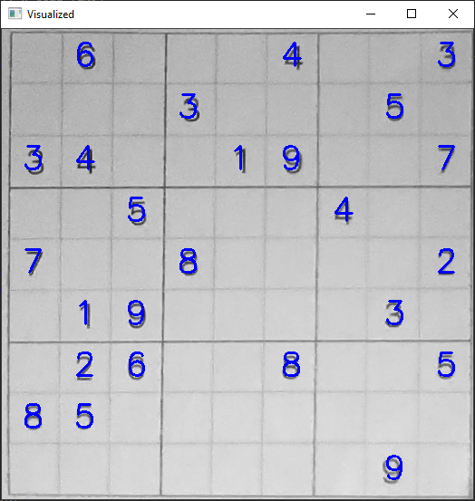
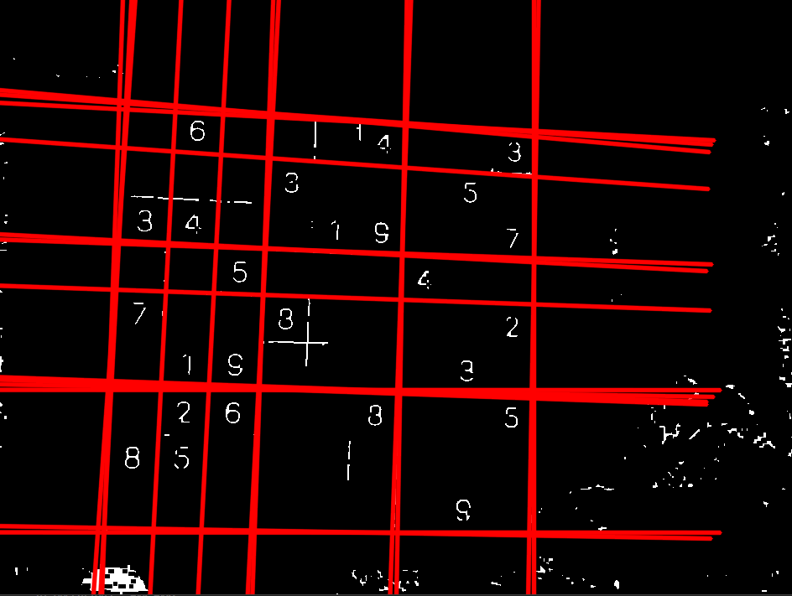
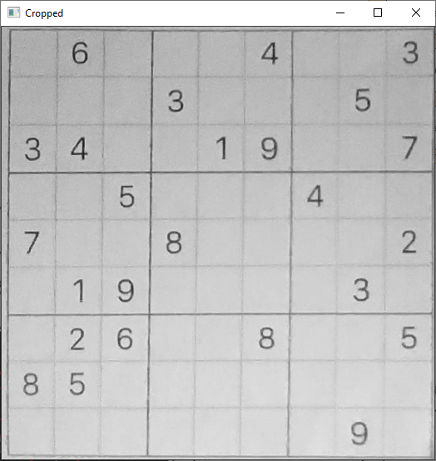
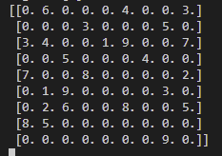



Sudoku Features

Slide 14
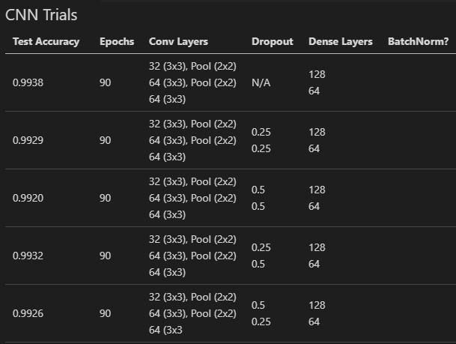
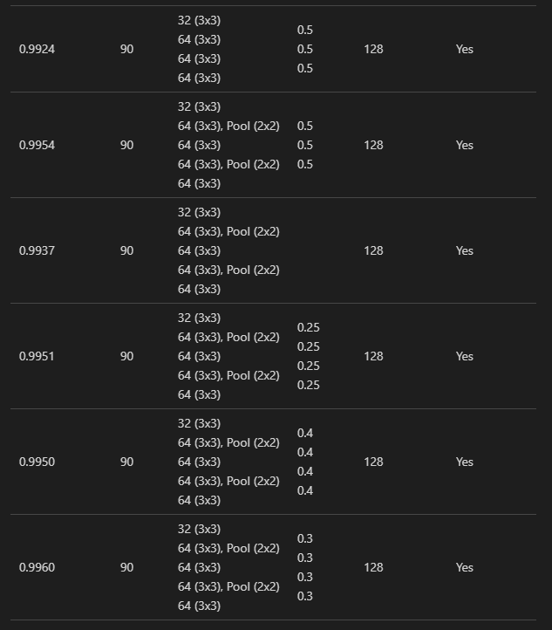
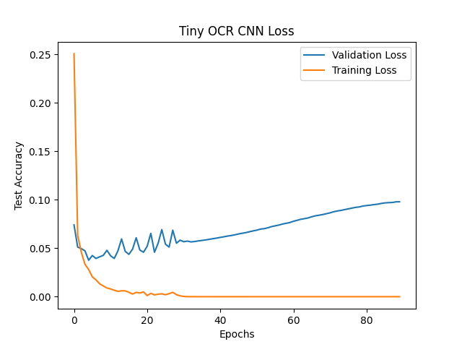
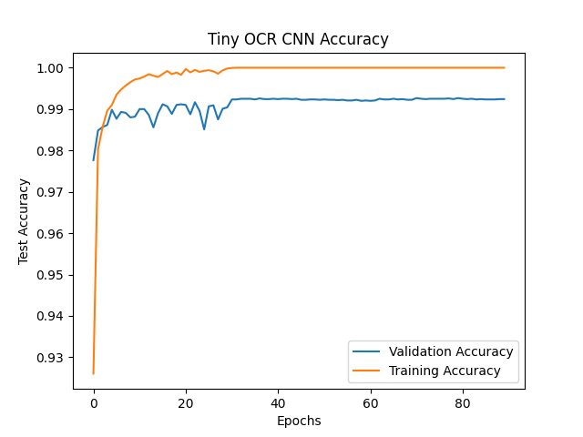
Sudoku Features Evaluation / Results
Robust puzzle identification and OCR extremely important
Handcrafted architecture development to optimize CNN

Slide 15
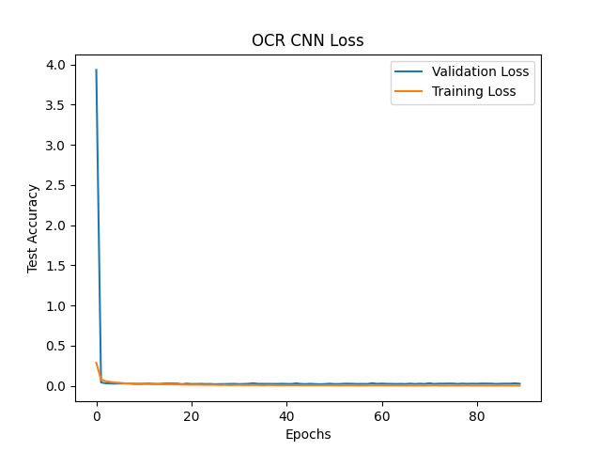
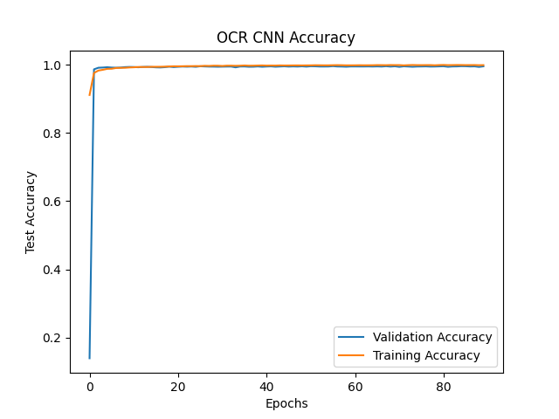
Sudoku Features Evaluation / Results
Robust puzzle identification and OCR extremely important
Handcrafted architecture development to optimize CNN

Slide 16
Final Results
SECTION 5

Slide 17
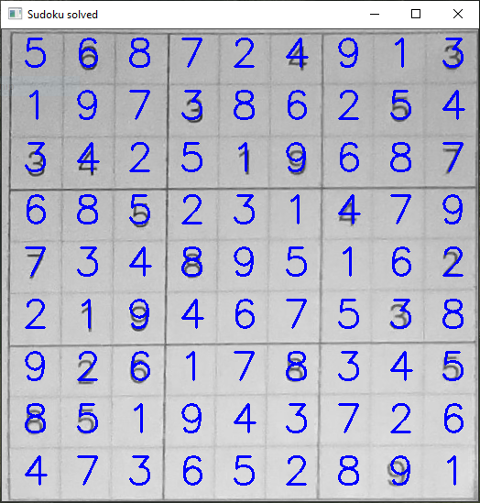
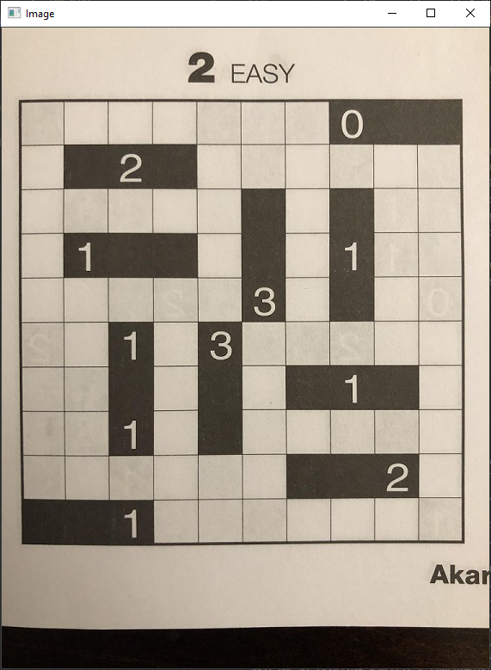
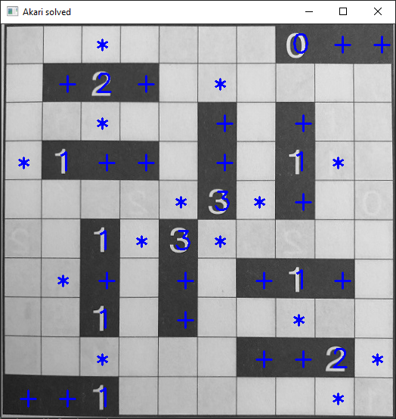

Slide 18
Discussion
SECTION 6

Slide 19
Discussion
Problem with pipeline model: a failure anywhere in the pipeline causes a failed solution...
Needs better CV: not very robust to lighting changes
(especially when identifying colors in Rubik’s cube)
In progress: CNN for Sudoku solution. Using iterative process (like game neural networks).

Slide 20
Questions?
Feel free to ask questions in the zoom chat.
Thanks!

Slide 21
References:
Papers:
Feng-hsiung Hsu. IBM’s deep blue chess grandmaster chips.IEEE Micro, 1999
Fei-Yue Wang, et al. Where does alphago go: From church-turing thesis to alphago thesisand beyond.IEEE/CAA Journal of Automatica Sinica, 3(2):113–120, 2016
Z. Markov, I. Russell, T. Neller, and N. Zlatareva. Pedagogical possibilities for the n-puzzleproblem. InProceedings. Frontiers in Education. 36th Annual Conference, 2006
S. Gur and O. Ben-Shahar. From square pieces to brick walls: The next challenge in solvingjigsaw puzzles. In2017 IEEE International Conference on Computer Vision (ICCV), 2017.
Lowe, D.G. Distinctive Image Features from Scale-Invariant Keypoints. International Journal of Computer Vision 60, 91–110 (2004)
Images:
https://static01.nyt.com/images/2017/05/24/technology/24bitsdaily-web/24bitsdaily-web-master768.jpg
https://allthatsinteresting.com/wordpress/wp-content/uploads/2015/11/deep-blue-chess-match.jpg

